Slide 1
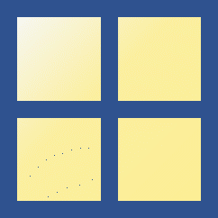





Scope of numeric type variables
Scope of numeric type variables
multi-dimensional arrays
(e.g., tensor)
multi-dimensional arrays
(e.g., tensor)
$$m×n×l⋯$$
$$m×n×l⋯$$
Numeric
matrix
Numeric
matrix
$$m×n$$
$$m×n$$
vector
vector
$$n×1$$
$$n×1$$
scalar
scalar
$$1×1$$
$$1×1$$

Slide 2
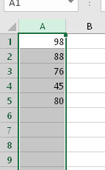
Examples of vector
Exam scores
Sound Signals
Images
7
6
5
5
5
2
1
1
3
4
4
4
3
1
3
2
2
3
2
1
3
2
4
3
2

Slide 3
vector
vector
vector
vector
vector
scalar
+
=
+
=

Slide 4





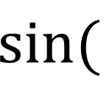









vector
vector
vector
$$0$$
$$0$$
$$0$$
$$\frac{π}{2}$$
scalar
$$1$$
$$1$$
$$\sin{(}$$
$$)$$
=
sum(
)
=
$$6$$
$$π$$
$$0$$
$$2$$
$$\frac{3π}{2}$$
$$−1$$
$$3$$

Slide 5
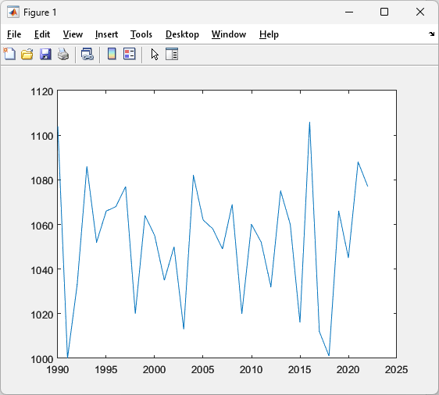

vector
vector
plot(
)
,
$$n×1$$
$$n×1$$
x-axis
y-axis

Slide 6

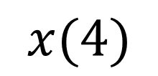

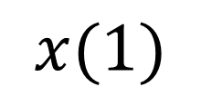



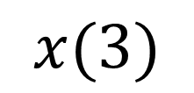



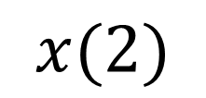

$$x:$$
$$3$$
$$5$$
$$2$$
$$4$$
$$x(1)$$
$$x(2)$$
$$x(3)$$
$$x(4)$$
$$3$$
$$5$$
$$2$$
$$4$$

Slide 7


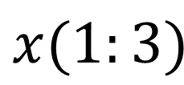






$$x:$$
$$3$$
$$5$$
$$2$$
$$4$$
$$x(1:3)$$
$$3$$
$$5$$
$$2$$

Slide 8

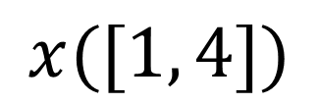

$$x:$$
$$3$$
$$5$$
$$2$$
$$4$$
$$x([1, 4])$$
$$3$$
$$4$$

Slide 9

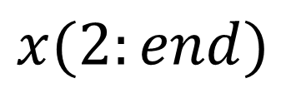



$$x:$$
$$3$$
$$5$$
$$2$$
$$4$$
$$⋯$$
$$x(2:end)$$
$$5$$
$$2$$
$$4$$

Slide 10













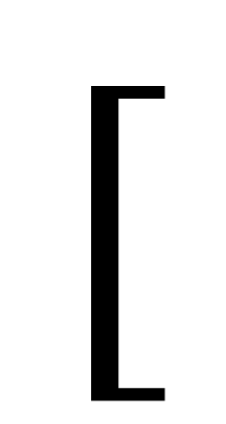
$$[$$
$$]$$
$$1$$
$$2$$
$$3$$
$$4$$
$$5$$
$$5$$
,
$$1$$
$$2$$
$$3$$
$$4$$
$$5$$
$$6$$

